Slide 1
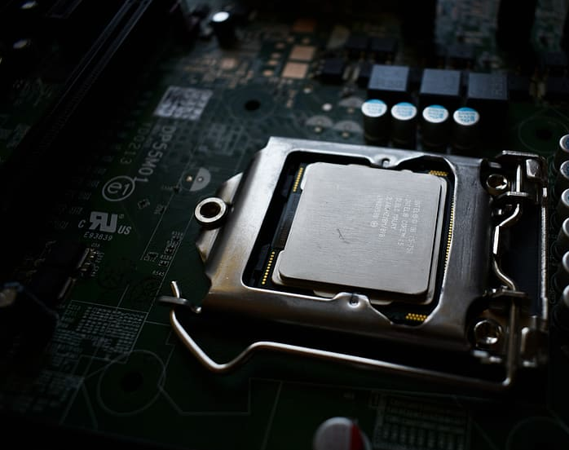

EECS 388: Embedded Systems, Spring 2023 Lecture 8 Practice Questions
Lecture 4
Instructor: Tamzidul Hoque, Assistant Professor, Dept. of EECS, University of Kansas (hoque@ku.edu), office: Eaton 2038
Credits: Some slides are adopted from Henk Corporaal’s Computer Architecture and Organization course

Slide 2
Practice Question 1
What is the MIPS assembly code for the C assignment statement below? A[12] = h + A[8];
Assume variable h is in register $s2
All elements of A is in memory and the base address of the array A is in $s3.

Slide 3
Practice Question 2
Convert the following instruction to hex using MIPS reference sheet
add $t0,$s1,$s2

Slide 4
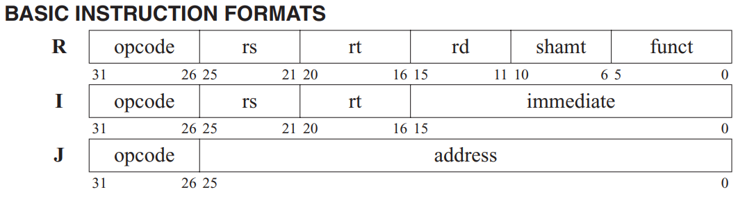
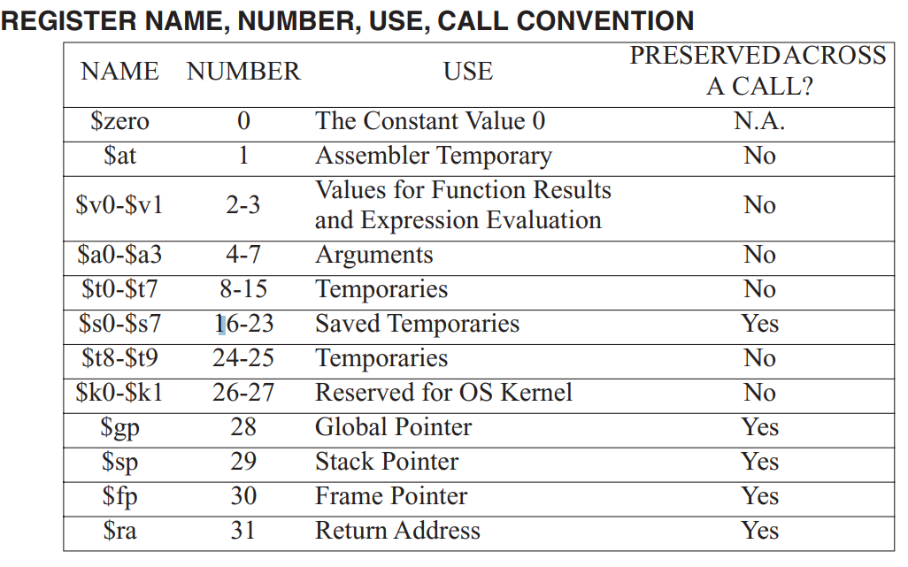
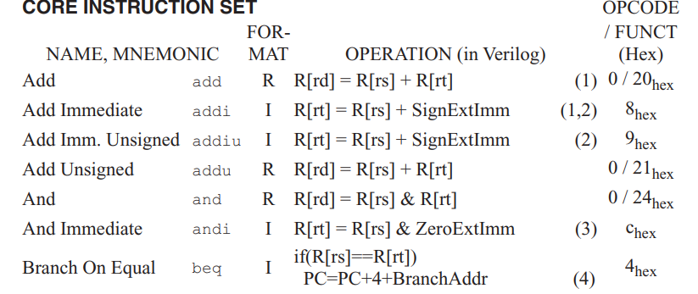
Reference
add $t0,$s1,$s2
Opcode=add
rs=s1, rt=s2, rd=t0
Not hex!

Slide 5
Practice Question 3
Convert the following instruction to hex using MIPS reference sheet
lw $t0,1200($t1)
sw $t0,1200($t1)
For first instruction:
Rs=t1, Rt=t0
Load Word =23(hex)
For second instruction:
Rs=t1, Rt=t0
Store Word =2b(hex)

